Slide 1
AUTOMATA & COMPUTABILITY
CSE 331, CSE BRAC

Slide 2
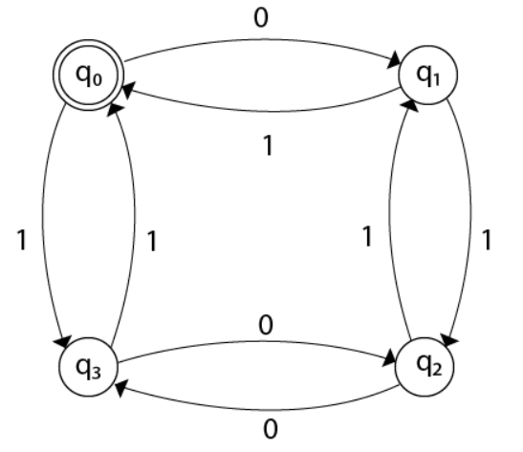
More DFA Design Problems
Design FA with ∑ = {0, 1} accepts even number of 0's and even number of 1's.
0

Slide 3
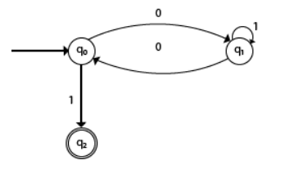
More DFA Design Problems (..contd)
Design a FA with ∑ = {0, 1} accepts the strings with an even number of 0's followed by single 1.

Slide 4
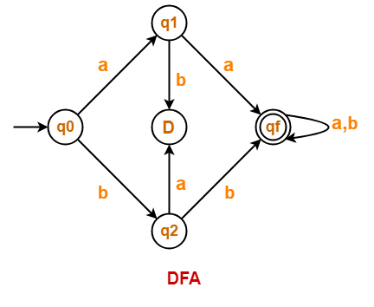
More DFA Design Problems (..contd)
Construct a DFA that accepts a language L over input alphabets ∑ = {a, b} such that L is the set of all strings starting with ‘aa’ or ‘bb’.

Slide 5
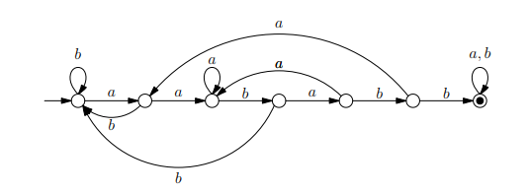
More DFA Design Problems (..contd)
Give a DFA for Σ = {a, b} that accepts any string with “aababb” as a substring.

Slide 6
More DFA Design Problems (..contd)
Length divisible by problems
Symbols divisible by problems
Starting with
Ending with
substring

Slide 7
Regular Expressions Example
Write regular expression for the strings containing the substring “baba”. Σ = {a, b, c}
(a|b|c)* baba (a|b|c)*

Slide 8
Regular Expressions Example
Write regular expression for the strings containing the subsequence “baba”. Σ = {a, b, c}
(a|b|c)*b(a|b|c)*a(a|b|c)*b(a|b|c)*a(a|b|c)*

Slide 9
Regular Expressions Example (..contd)
Write the regular expression for the language starting with a but not having consecutive b's.
(a + ab)*

Slide 10
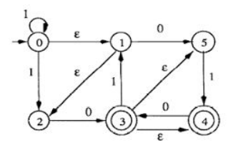
NFA/e-NFA to DFA
Convert the following NFA to DFA:

Slide 11
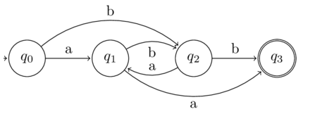
DFA to r.e
bb + (a+ba)(ba)*(a+bb)

Slide 12
Thank You

